Slide 1
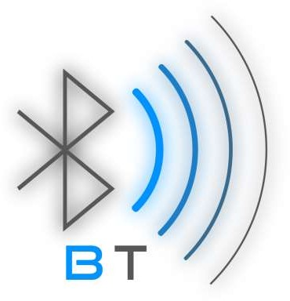
Bluetooth

Slide 2

What is this so called Bluetooth?
Bluetooth is a short-range and low power wireless technology originally developed for exchanging data over short distances from fixed and mobile devices, creating personal area networks(PAN)
Bluetooth technology is the implementation of a protocol defined by the IEEE 802.15 standard
Effective range of Bluetooth devices is 10 meters.
It was originally conceived as a wireless alternative to data cables
Short-range radio frequency technology that operates at 2.4 GHz on an unlicensed Industrial Scientific Medical (ISM) band.

Slide 3

Different Versions of Bluetooth
There are number of Bluetooth versions which all are being
developed to meet the particular requirements of the time.
They come with different specifications to offer different options to the users. I think we all need to know about various versions of Bluetooth so that whenever pairing one Bluetooth enabled device with another Bluetooth headset we don’t face any kind of difficulty.
All the updated versions of Bluetooth offer backward version compatible. This means whichever newer version you are using then it is compatible with the older version as well.

Slide 4
Bluetooth v1.2
Backward compatible with v1.1, faster connection and discovery.
Recovered confrontation to radio frequency interference by avoiding the use of crowded frequencies in the hopping sequence.
Data transmission speed up to 721 Kbit /s.
Bluetooth v2.0
Backward compatible with the previous v1.2.
Enhanced Data Rate (EDR) for faster data transfer.
The nominal rate of EDR is about 3 Mbit /s.

Slide 5
Bluetooth v2.1
Backward compatible with v1.2.
Uses secure simple pairing (SSP) to improve a better pairing experience for Bluetooth devices.
Uses sniff sub rating, which reduces the power consumption in low-
power mode.
Bluetooth v3.0
Backward compatible with v2.1.
Bluetooth 3.0 provides theoretical data transfer speeds of up to 24 Mbit / s.
For high data rate traffic this version uses the adjacent 802.11 link.

Slide 6
Bluetooth v4.0
Backward compatible with v3.0.
Provides faster speed in data transmission than the earlier version.
It comes with greatly reduced power consuming, as if it does not require any power at all to function.
It provides more security in data transmission than the earlier version.
Bluetooth technology is developing from day to day and one major feature of any version is just making the newer version superior over the earlier version.
However more updated versions of Bluetooth technology will be keep on coming in future to meet all the requirements of the users.

Slide 7
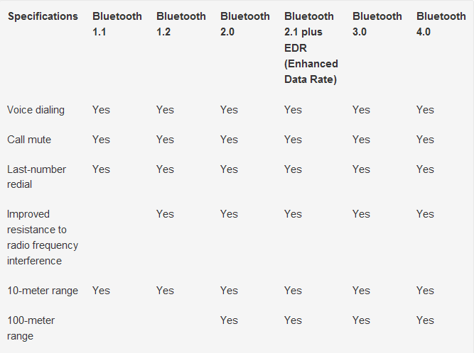
Comparison of different versions of Bluetooth

Slide 8
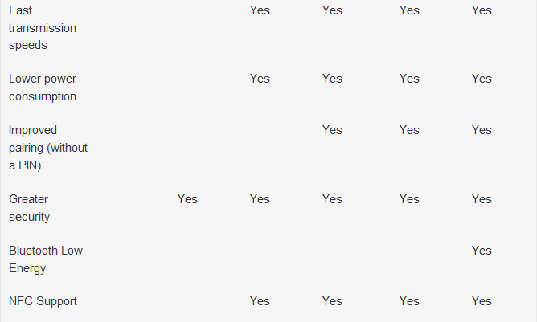

Slide 9
Importance of Bluetooth
A Cable Replacement Technology
It’s wireless and allow communication between devices.
It’s inexpensive.
You don’t have to think about it. (Maintenance)
Multiple devices access.

Slide 10
Power Efficiency
Lightweight and small form factor
Easy to use
Reliable and resilient to failures

Slide 11

Advantages & Disadvantages of Bluetooth
Advantages :
It is cheap.
Easy to install.
It makes connecting to different devices convenient .
It is wireless.
It is free to use if the device is installed with it.

Slide 12

Disadvantages :
It can be hacked into.
If installed on a cell phone it is prone to receiving cell phone viruses.
It only allows short range communication between devices.
It can only connect two devices at once.
It can lose connection in certain condition.

Slide 13




Bluetooth V/S Other Wireless Technology

Slide 14

Infrared technology
IR wireless is the use of wireless technology in devices or systems that convey data through infrared (IR) radiation
Ideal Application : Device Synchronization, Data transfer
Range (m): 1
Data Rate (mbps): 16
Current Required: Low
Cost($): 10

Slide 15
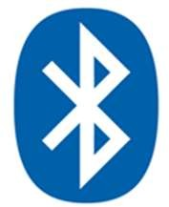
Bluetooth
Bluetooth is a specification (IEEE 802.15.1) for the use of low- power radio communications to link phones, computers and other network devices over short distances without wires.
Ideal Application : Cable Replacement
Range (m): 10 - 100
Data Rate (mbps): Less than 1
Current Required: Medium
Cost($): 10

Slide 16

Wi-Fi
Wi-Fi (IEEE 802.11) is the name of a
popular wireless networking technology that uses radio waves
to provide wireless high-speed Internet and network connections.
Ideal Application : High Speed LAN
Range (m): 100 +
Data Rate (mbps): 11
Current Required: High
Cost($): 45

Slide 17


Different phases of Bluetooth Hands free kit connection
Hello, I am looking for bluetooth devices
Discovery
Pairing
Detection of Profiles
Connection Data
Synchronisation
Hello, I am an available Bluetooth device

Slide 18
What is your authentification Code ?
Discovery
1234…
This code has to be typed on your keyboard
Pairing
Detection of
Profiles
Connection Data
Synchronisation
Ok !
Now we are paired

Slide 19
What type of profile do you support ?
Discovery
Pairing
I can do headset and hands-free. What about you ?
Detection of Profiles
Connection
Data
Synchronisation

Slide 20
Ok, we are now connected in Hands-free.
Discovery
Pairing
Detection of Profiles
Connection
I can do hands-free.
Data
Synchronisation

Slide 21
Discovery
Pairing
Detection of Profiles
Connection
To complete my phonebook, I have to synchronise with your contacts
Ok, I transfer my 163 contacts.
Data
Synchronization

Slide 22
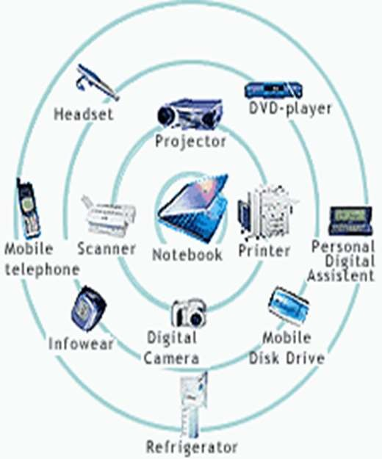

So how does it really work?
Bluetooth is a standard for tiny, radio frequency chips that can
be plugged into your devices
These chips were designed to take all of the information that your wires normally send, and transmit it at a special frequency to something called a receiver Bluetooth chip.

Slide 23
Architecture
Bluetooth defines two types of networks: piconet and
scatternet
Piconets
A Bluetooth network is called a piconet, or a small net.
A piconet can have up to eight stations, one of which is called the primary and the rest are called secondary's.
Piconet can have only one primary station. The communication between the primary and the secondary can be one-to-one or one- to-many.

Slide 24
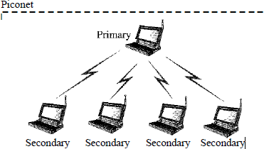
Although a piconet can have a maximum of seven secondaries, an additional eight secondaries can be in the parked state.
A secondary in a parked state is synchronized with the primary, but cannot take part in communication until it is moved from the parked state.
Because only eight stations can be active in a piconet, activating a station from the parked state means that an active station must go to the parked state.

Slide 25
Scatternet
Piconets can be combined to form what is called a scatternet
A secondary station in one piconet can be the primary in another piconet. This station can receive messages from the primary in the first piconet (as a secondary) and, acting as a primary, deliver them to secondaries in the second piconet.
A station can be a member of two piconets

Slide 26
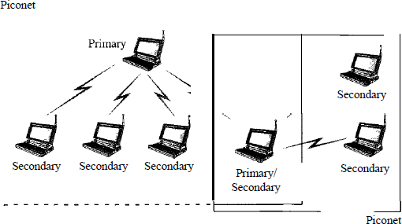

Slide 27

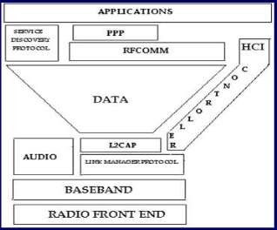
ARCHITECTURE STRUCTURE

Slide 28
COMPONENTS OF ARCHITECTURE
Radio Front End (RF)
Defines characteristics of RF, frequency bands, channel arrangements & receiver sensitivity level.
Logical Link Control & Adaptation Protocol (L2CAP)
For transporting bigger data products to higher layer.
Service Discovery Protocol (SDP)
To query and discover services supported by peer Bluetooth devices.

Slide 29

Link Manager Protocol (LMP)
PICONET, master slave role assignments and link configuration.
Security configuration by device authentication using secret key.
RFCOMM
Provides transport capabilities for high level services.

Slide 30
Future Of Bluetooth
Bluetooth has a good future ahead because it meets a basic need of connectivity.
Currently a protocol is being researched that would support large ad hoc networks.
Latest version of Bluetooth are improving both its security and capabilities.
Ultra wide band has been chosen by the Bluetooth Special Interest Group as the future of Bluetooth Technology.
New versions of Bluetooth technology will meet the high-speed and large range.
Many companies are designing impressive Bluetooth applications in demand.

Slide 31
Conclusion
A new global standard for data and voice
Eliminates Cables .
Low Power, Low range, Low Cost network devices.
Bluetooth seems to have a bright future after reviewing its
benefits and wide use.
Further improvements are planned to be made in
Data Rates
Power Reduction
Range

